Slide 1
Customer Relationship Management (CRM)
By: Vajihehalsadat Seyedzadeh & Winoto Janputra
What is CRM?
Customer relationship management (CRM) is a technology to manage and analyze customer interactions throughout the customer lifecycle, with the goal of improving business relationships with current customers and potential customers. CRM systems are designed to compile information on customers across different channels which could include the company's website, telephone, live chat, direct mail,…

Slide 2
Background
Mini CRM to Record current Customer information and potential customers
Record every interaction between Customer and Sales Person
Ability of show works day of Sales Person
Track Sales Person activity
Show reports as a data table and diagram with ability of export in to excel file and print in to
Increase efficiency
The goal is simple: Improve business relationships.

Slide 3
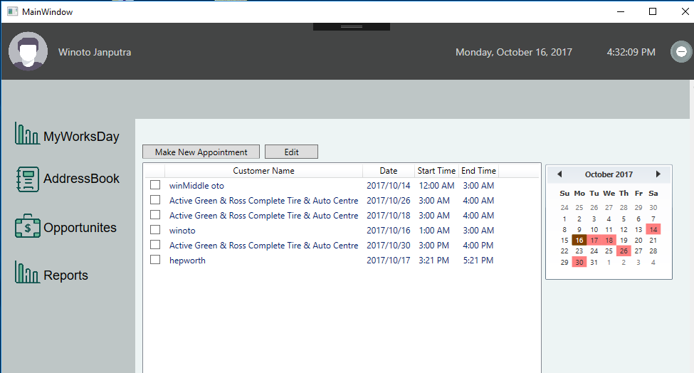
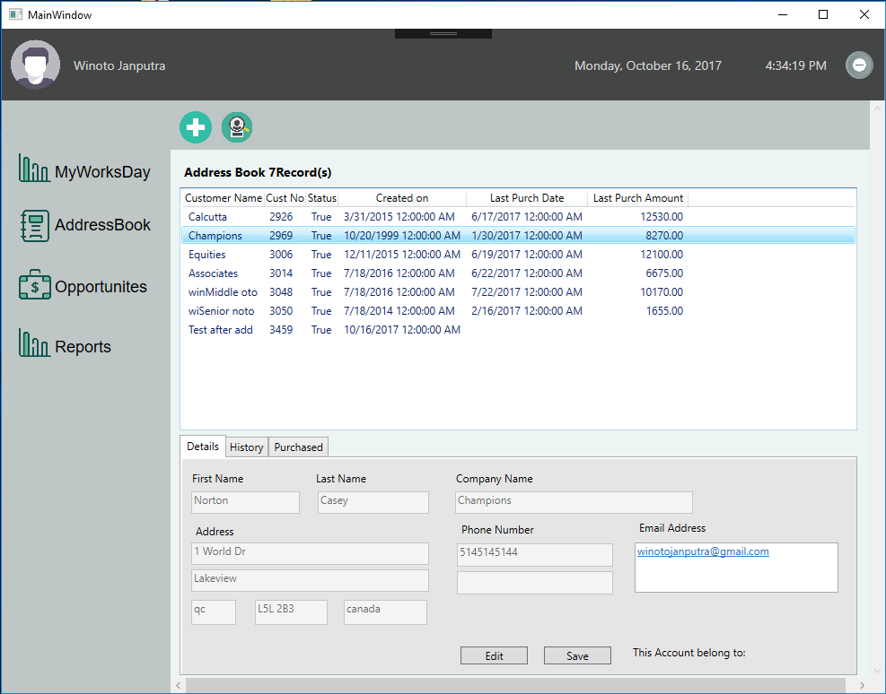
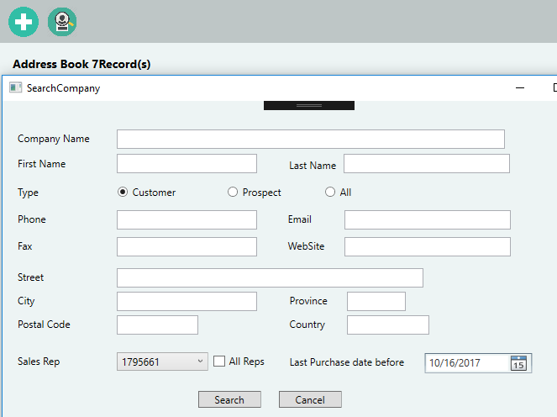
See Customer list with its:
contact information, conversation and purchased history
Add new customer
Search new customer
See Activities
Add new or Edit Appointment

Slide 4
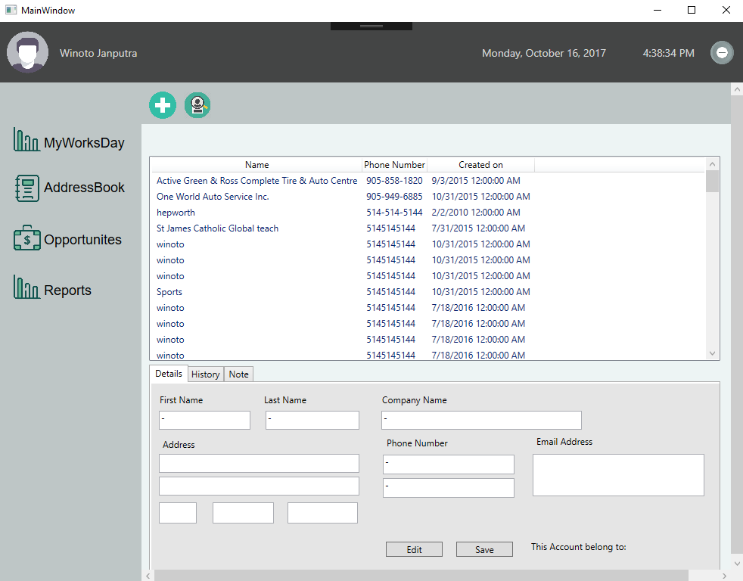
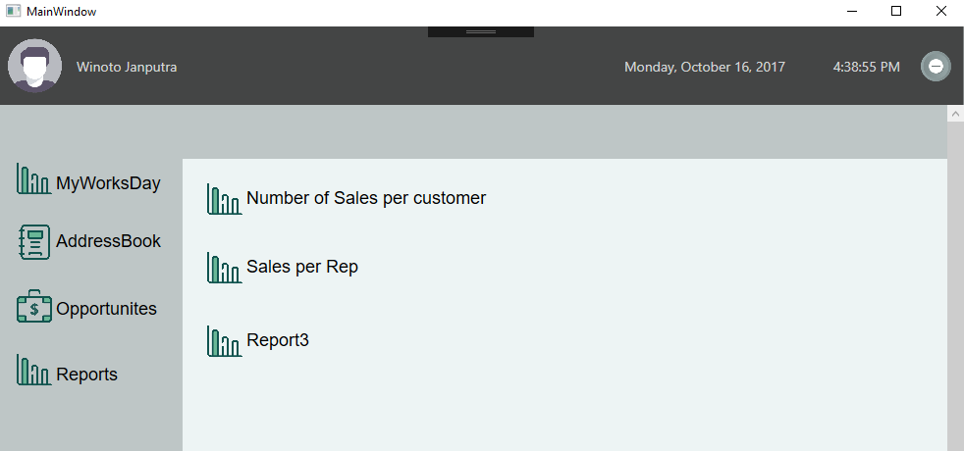
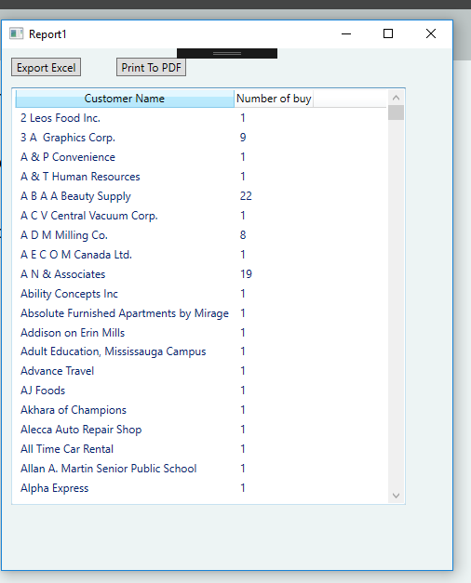
Report
Number of Sales per Customer to excel and PDF
Sales Per Sales Rep YTD
See Prospect list with its:
contact information, conversation
Add new and Search prospect

Slide 5
Use Frame in Main Window
Keep user id from login screen to be used in other pages
Prevent user to close login screen without enter the information
Workday
Changed the background of the calendar
Record in Outlook and send the meeting to recipient
Send Email using Outlook
Export to Excel and PDF
Create Graphic with multiline
Sorting
TOTAL 4 SLIDES
Low level, solve the problem

Slide 6
Localization
Installation
Change the view of the Calendar

